Slide 1
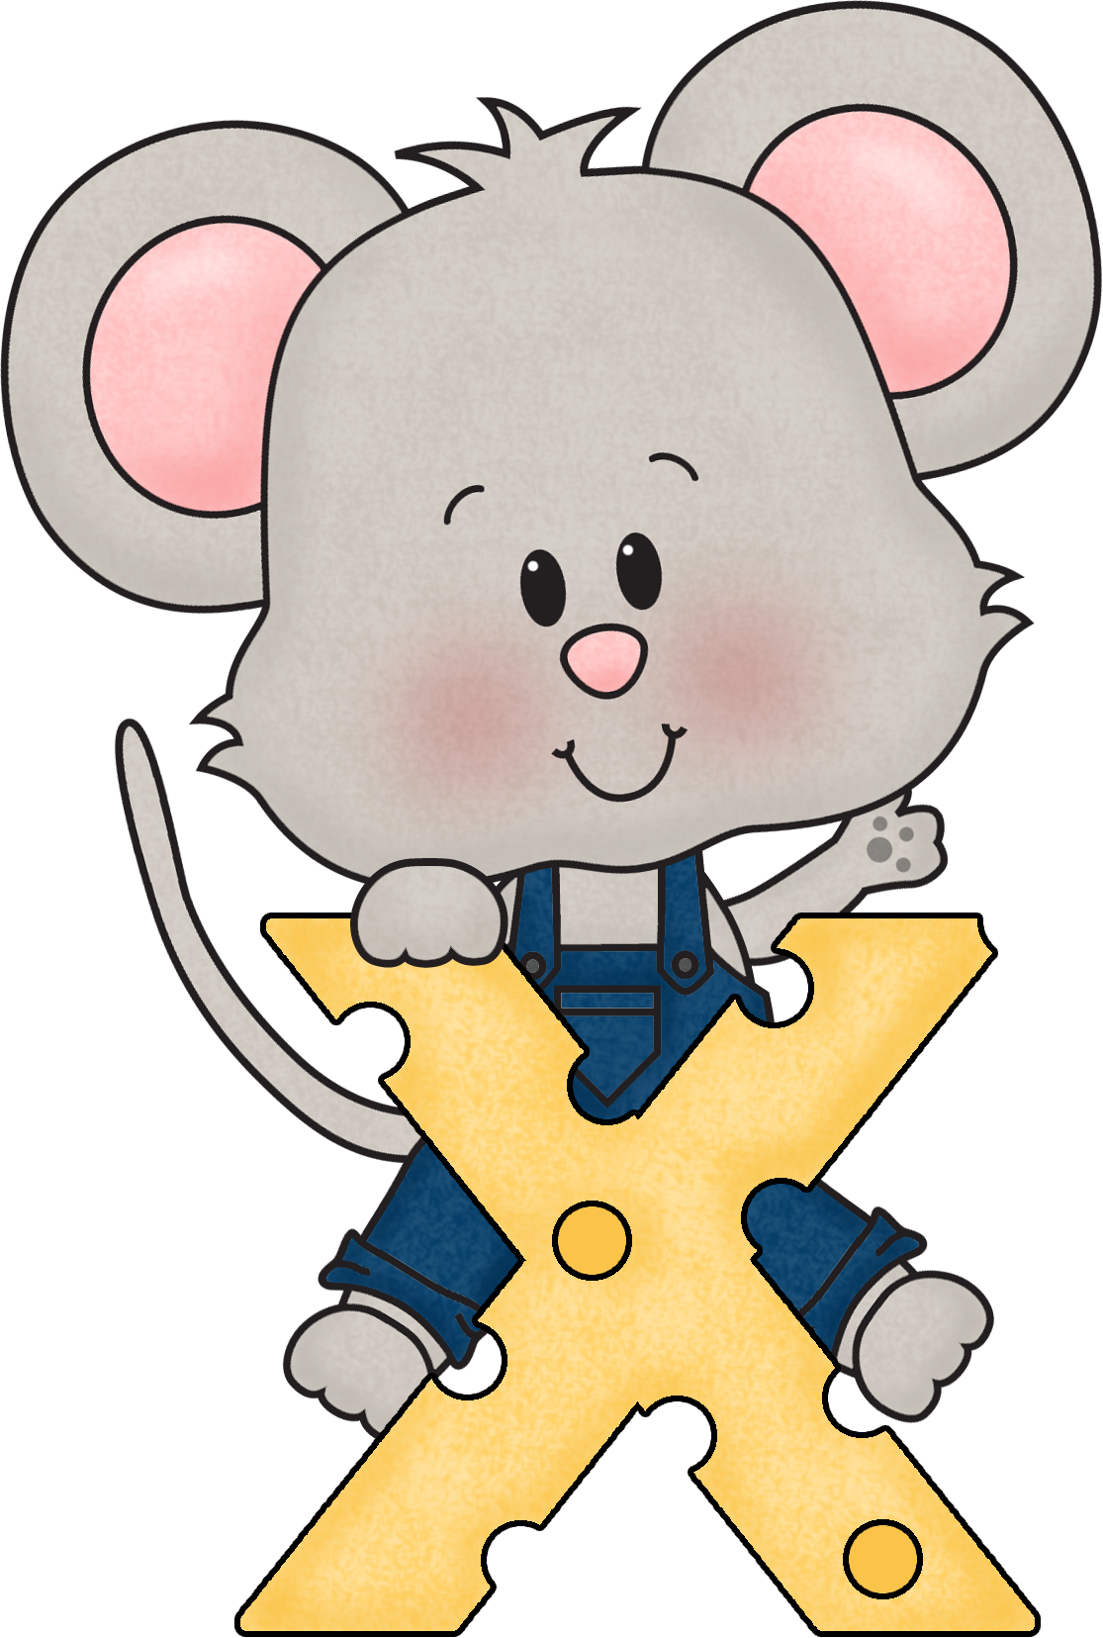
Multiplication Chants & Songs
1. Click “Slide Show” at top.
2. Click “From Beginning”.
3. Click on the screen to go to next page.

Slide 2
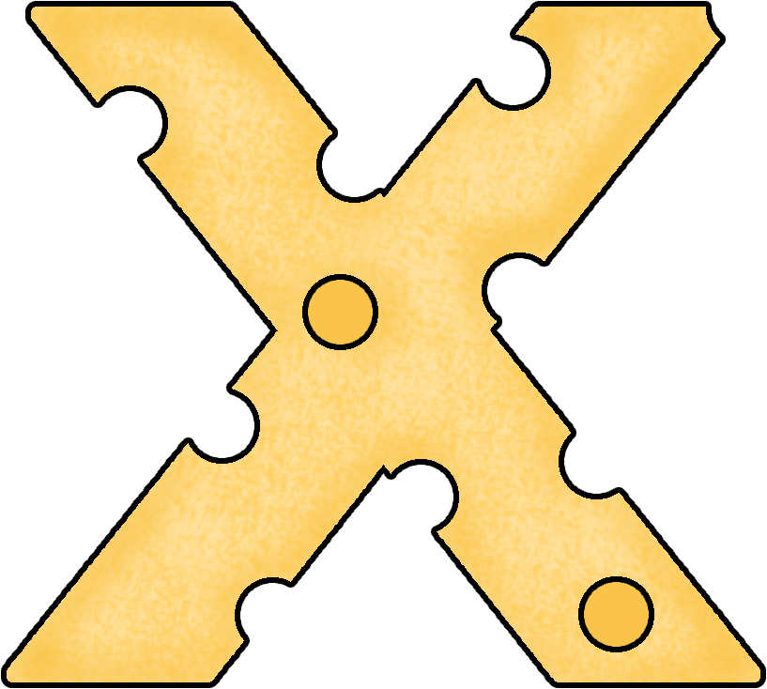
Parent Page:
Thanks for visiting! We use chants/songs in class to learn to count by 2s, 3s, 4s, 5s, 6s, 7s, 8s, & 9s.
If you play the PowerPoint like a slideshow, you can hear the songs/chants automatically-turn on your volume.
If you want to hear the chant or song put your mouse over the cheese number and click the “play” symbol.
Hope you enjoy this!

Slide 3
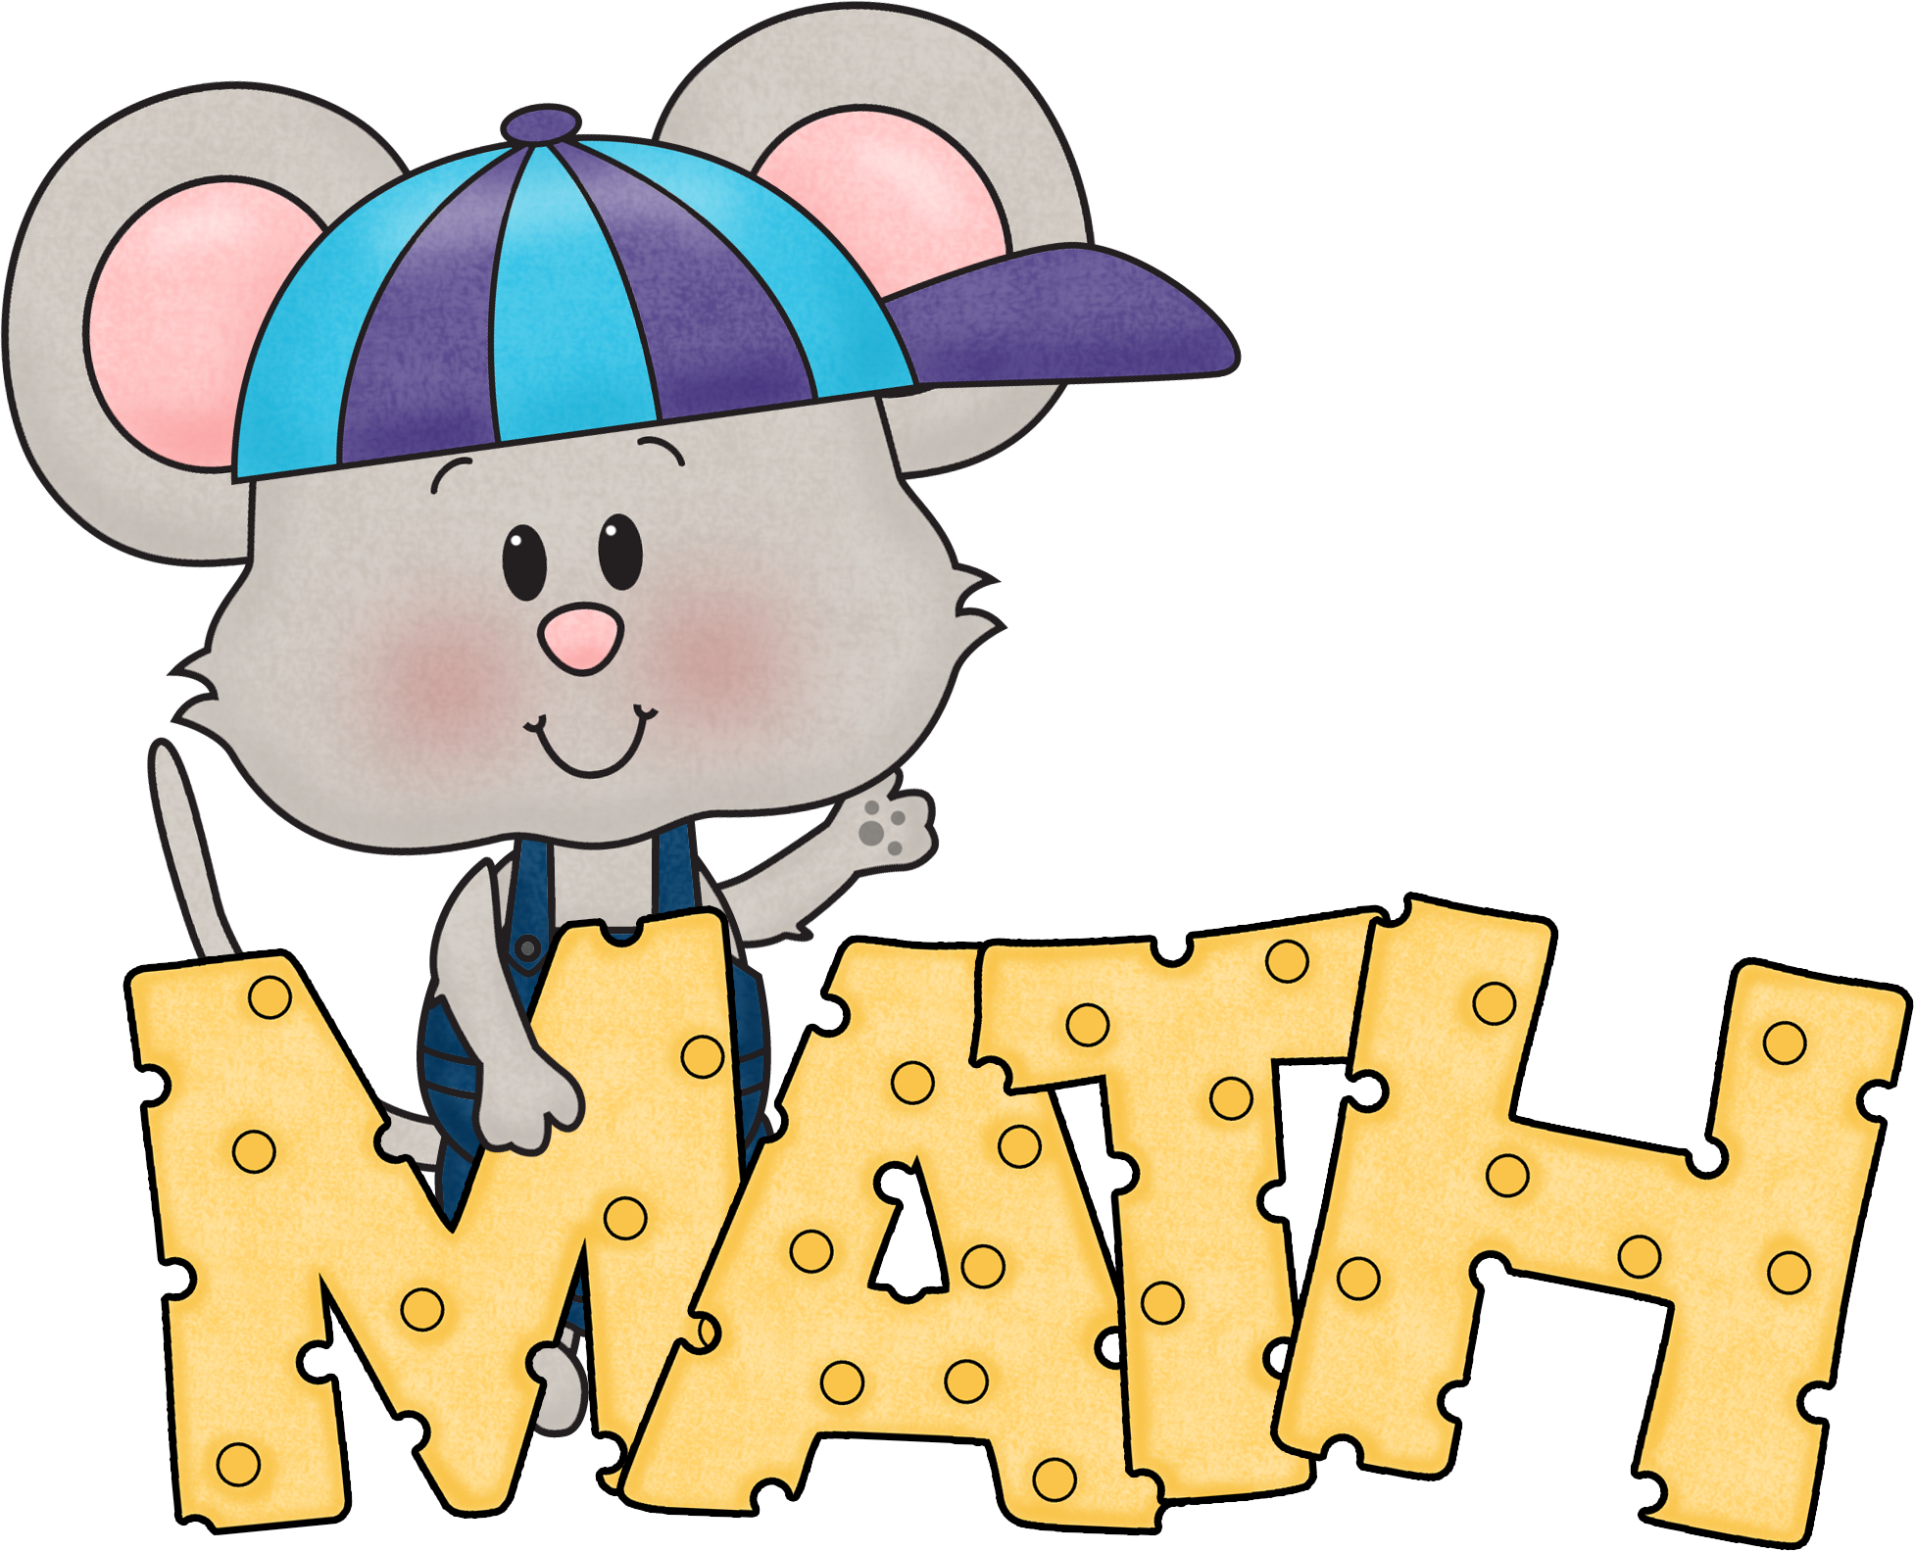
2s, 5s, and 10s
For these facts, we just count normally by the numbers.
2, 4, 6, 8, 10, 12, 14, 16, 18, 20, 22, 24
5, 10, 15, 20, 25, 30, 35, 40, 45, 50, 55, 60
10, 20, 30, 40, 50 , 60 , 70, 80, 90, 100, 110, 120

Slide 4
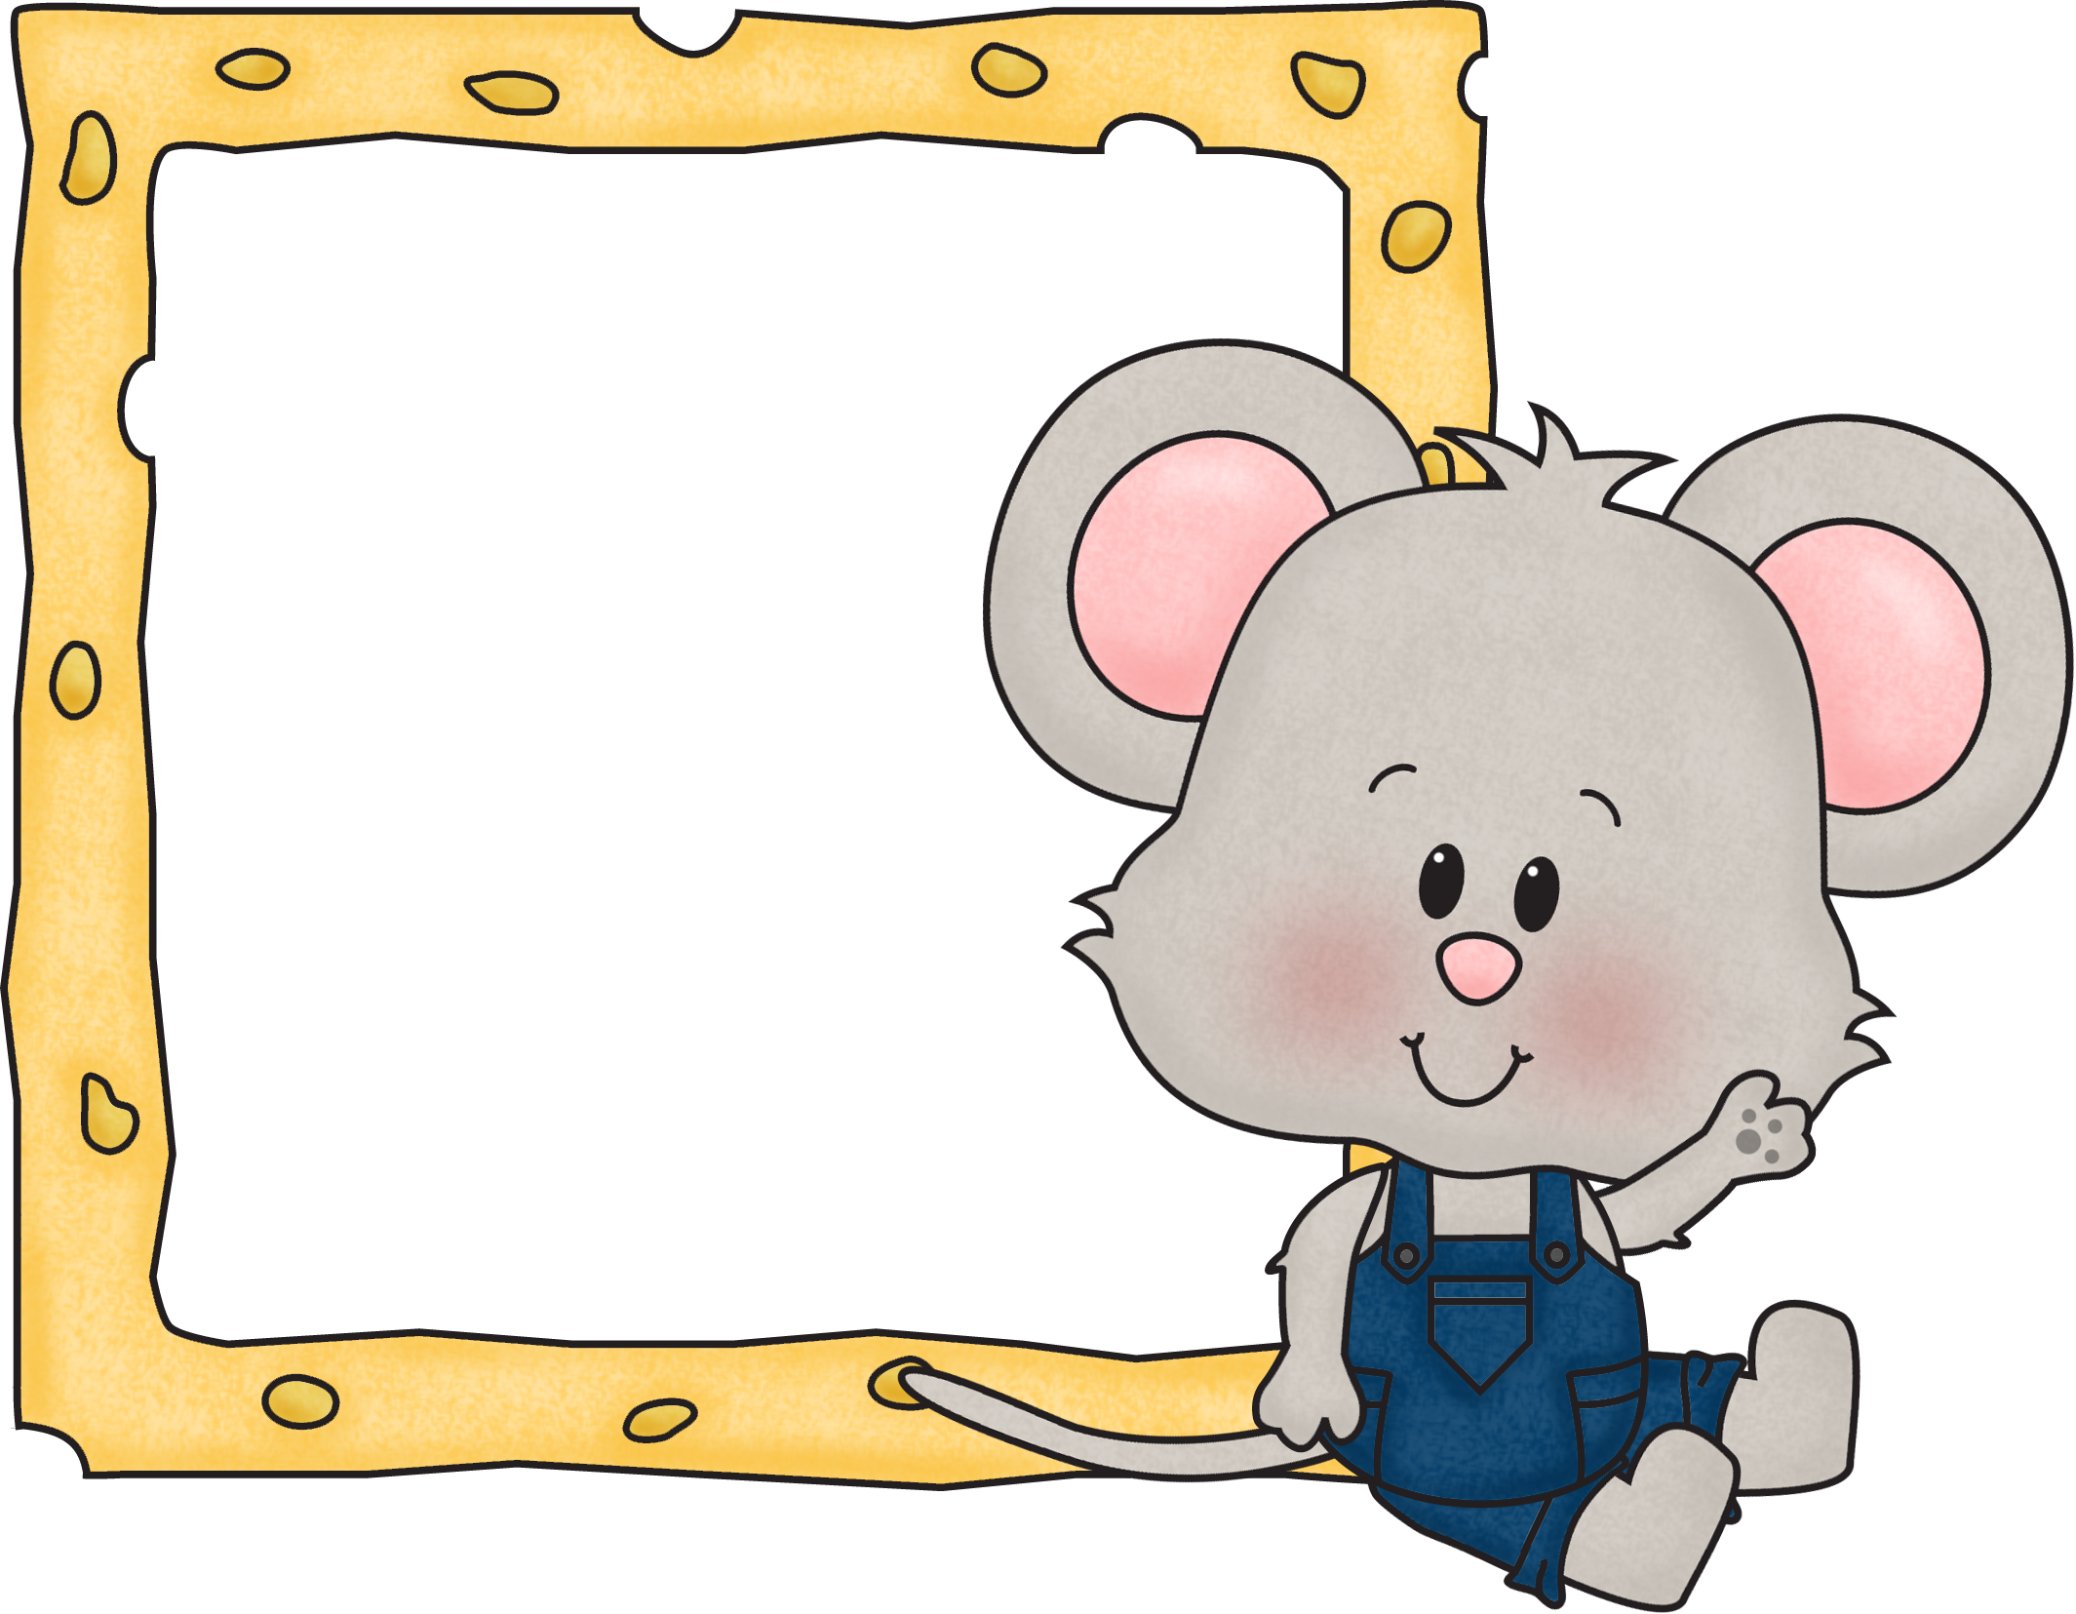
Chant
3, 6, 9
12, 15, 18
21, 24, 27
30
33, 36

Slide 5
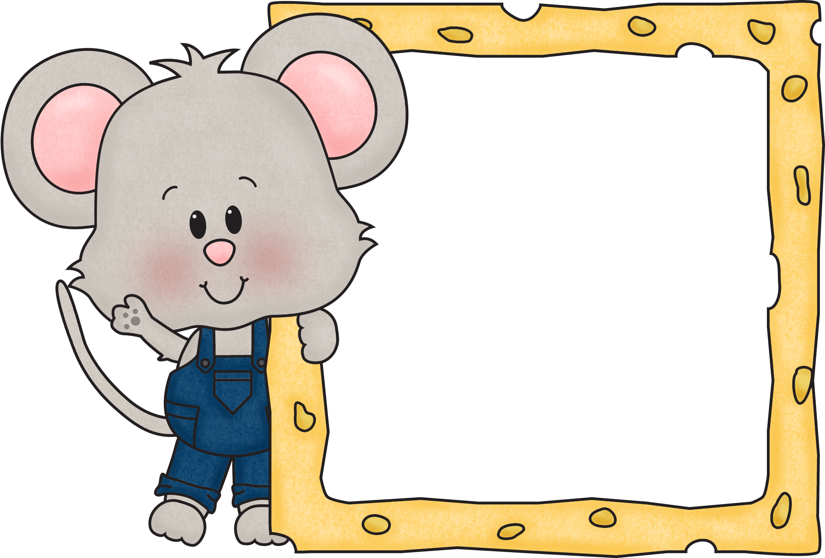
Row, Row, Row Your Boat
4, 8, 12, 16
20, 24
28, 32
36, 40
44, 48

Slide 6
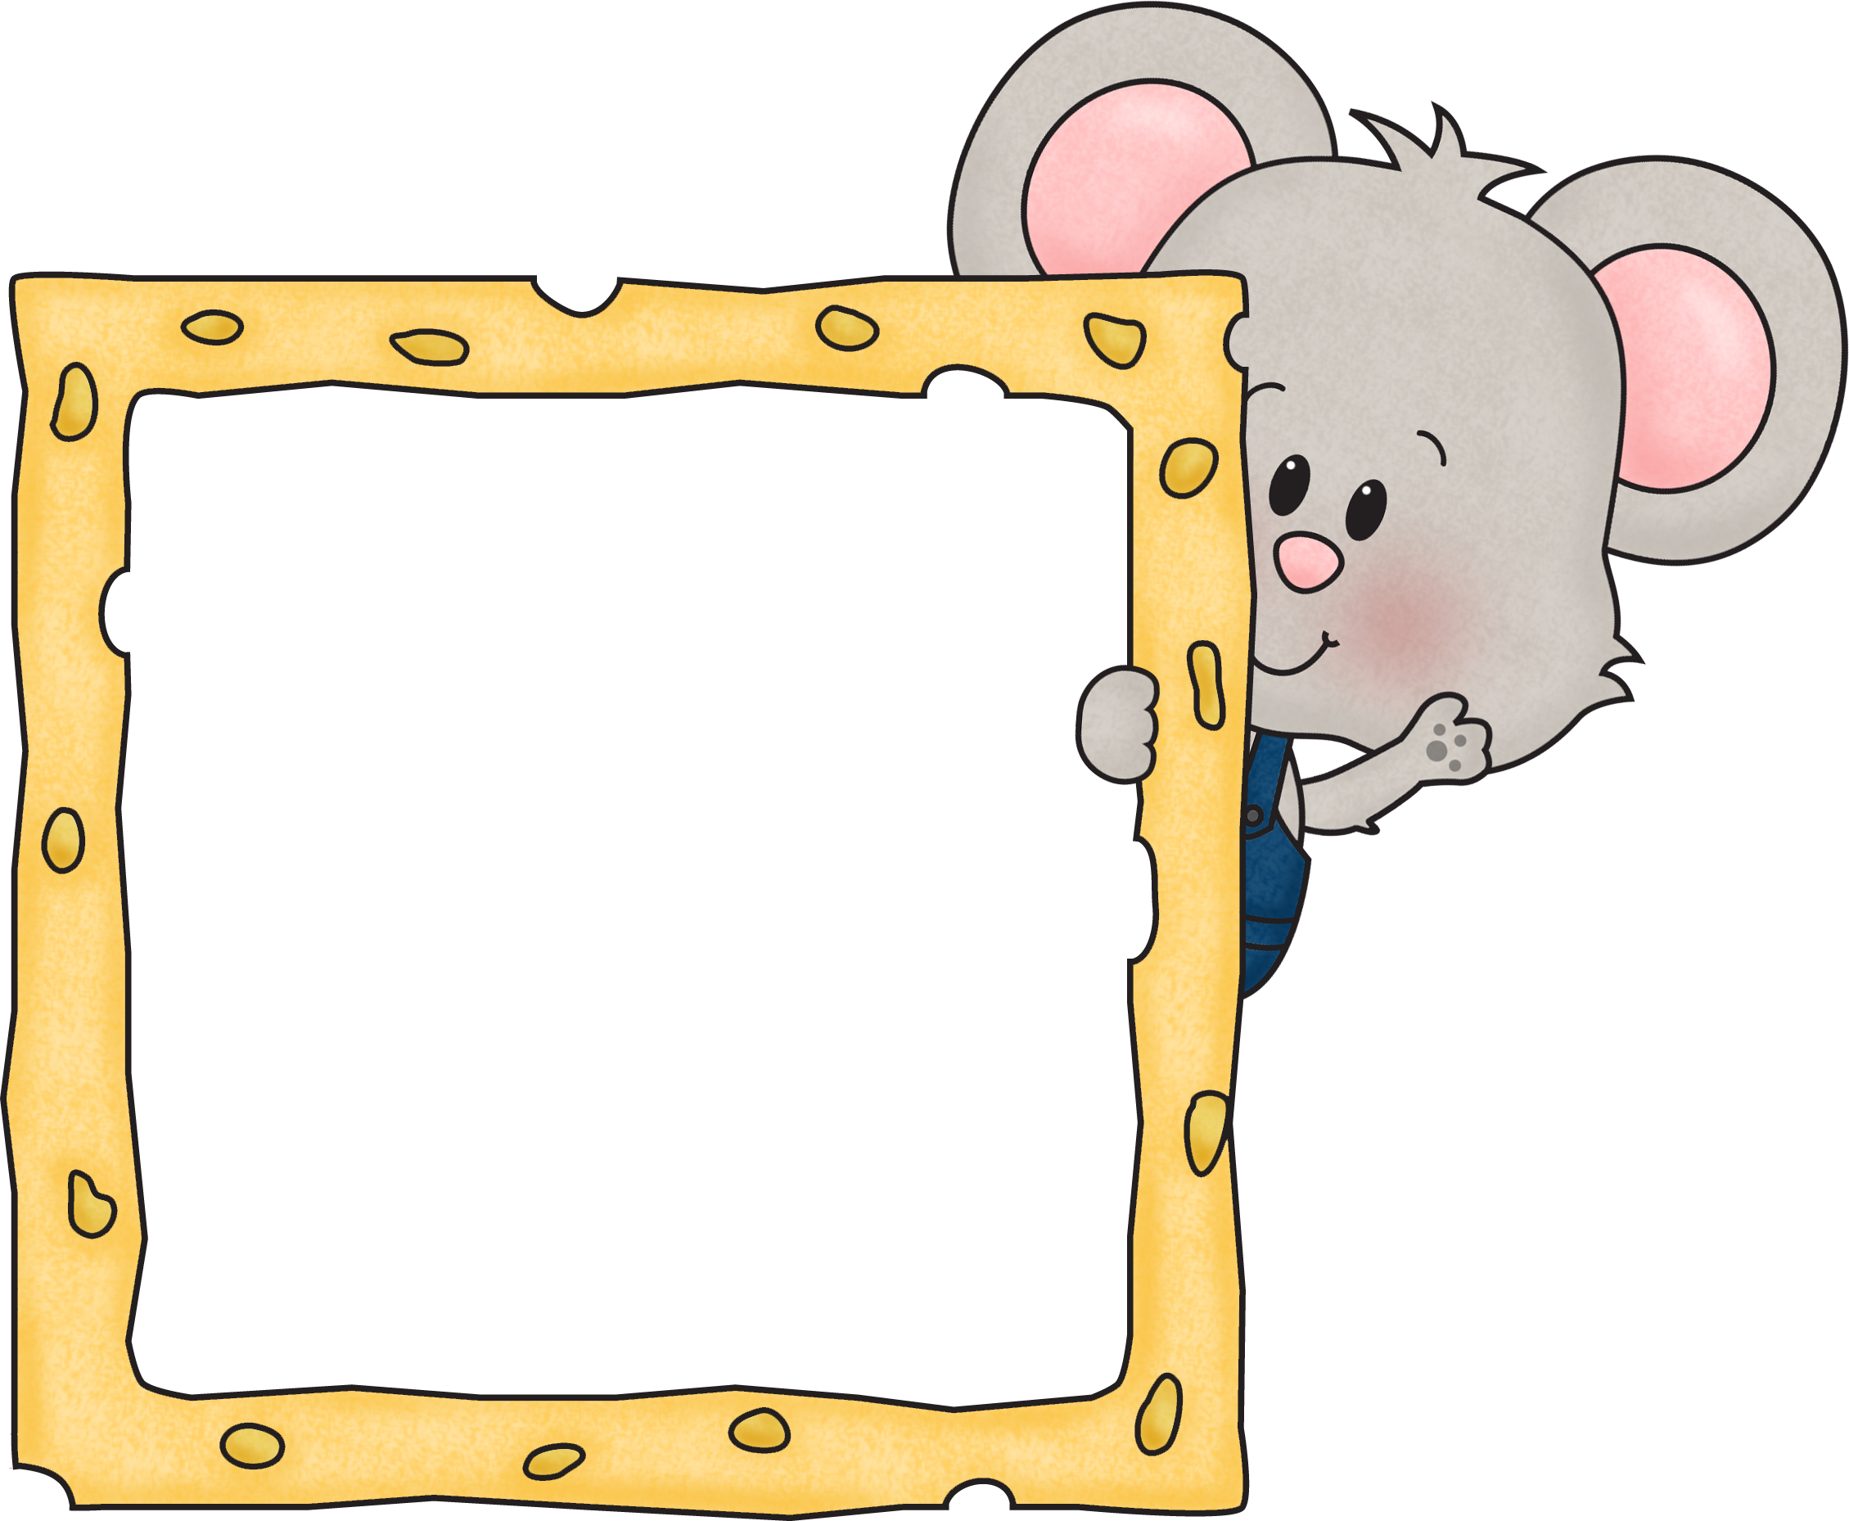
10 Litte Indians
6, 12, 18, 24
30, 36
42
48, 54, 60, 66
and there’s 72
Whoo Hoo!

Slide 7
Twinkle, Twinkle Little Star
7, 14, 21
28, 35
42 and 49
56, 63
70 and 77
Then there’s 84

Slide 8
Jingle Bells
8, 16, 24
32
40, 48
56
64, 72
80, 88
and don’t forget about 96!

Slide 9
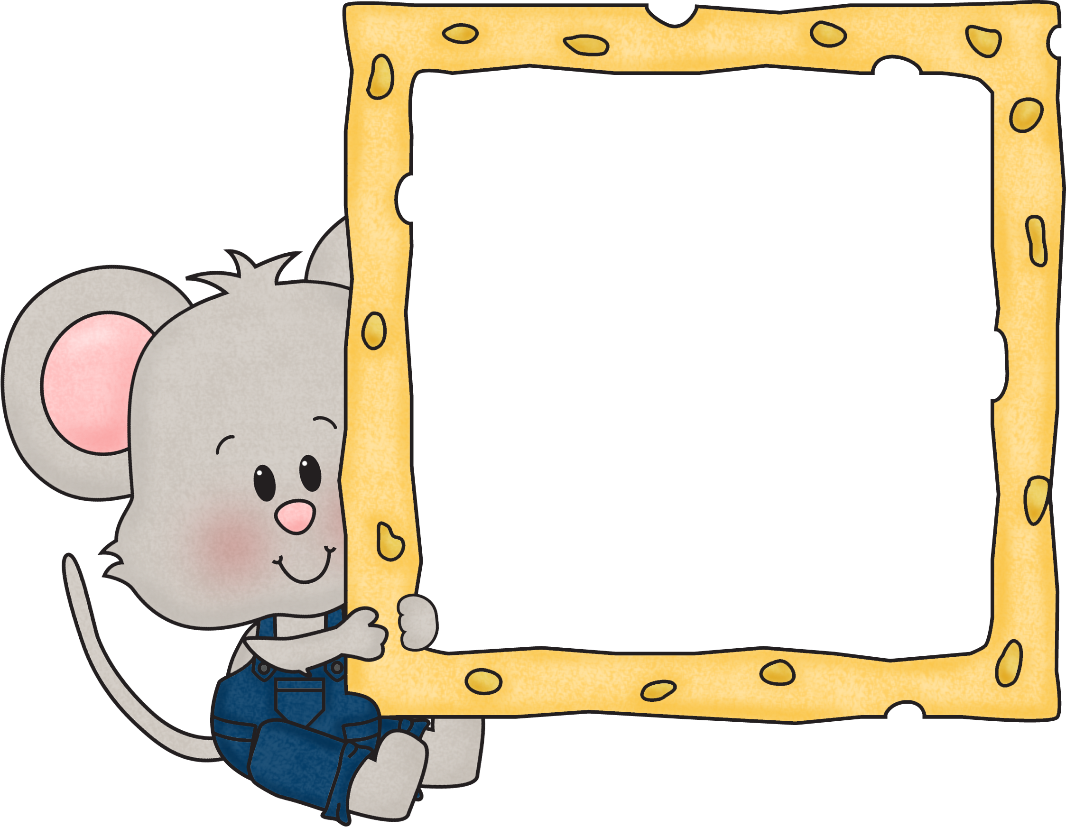
Rudolph the Red Nose Reindeer
9, 18, 27
36, 45
54 and 63
72 and 81
After that then there’s 90,
Followed by 99.
Last is the number 108.
Now I know my 9s just fine!

