Slide 1
Map in a Month Project
Mrs. Volk’s Class

Slide 2
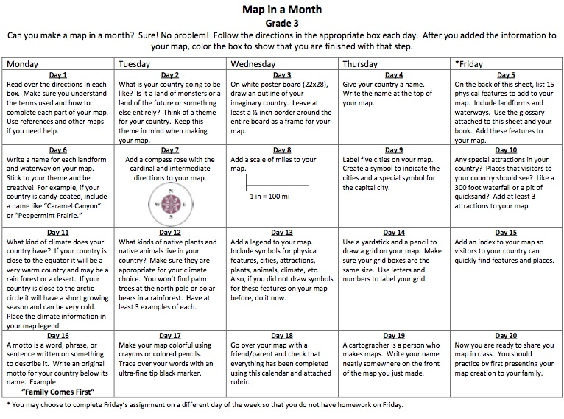
Calendar

Slide 3
Here is a quick list of what is required on your map:
1. Your name.
2. Handed in on time.
3. Map is colored in.
4. A consistent theme.
5. Your country is thematically named and displayed on a map.
6. At least 15 geographic features (rivers, lakes, mountains, etc.) included.
7. Each geographic feature is thematically named.
8. A compass rose.
9. A map scale.
10. At least 5 cities are labeled using symbols. (Capital too)
11. At least 3 special attractions.
12. Climate is mentioned.
13. At least 3 plants AND 3 animals are labeled.
14. A map key.
15. A coordinate grid using numbers and letters.
16. A motto.

Slide 4
Grading Rubric

Slide 10
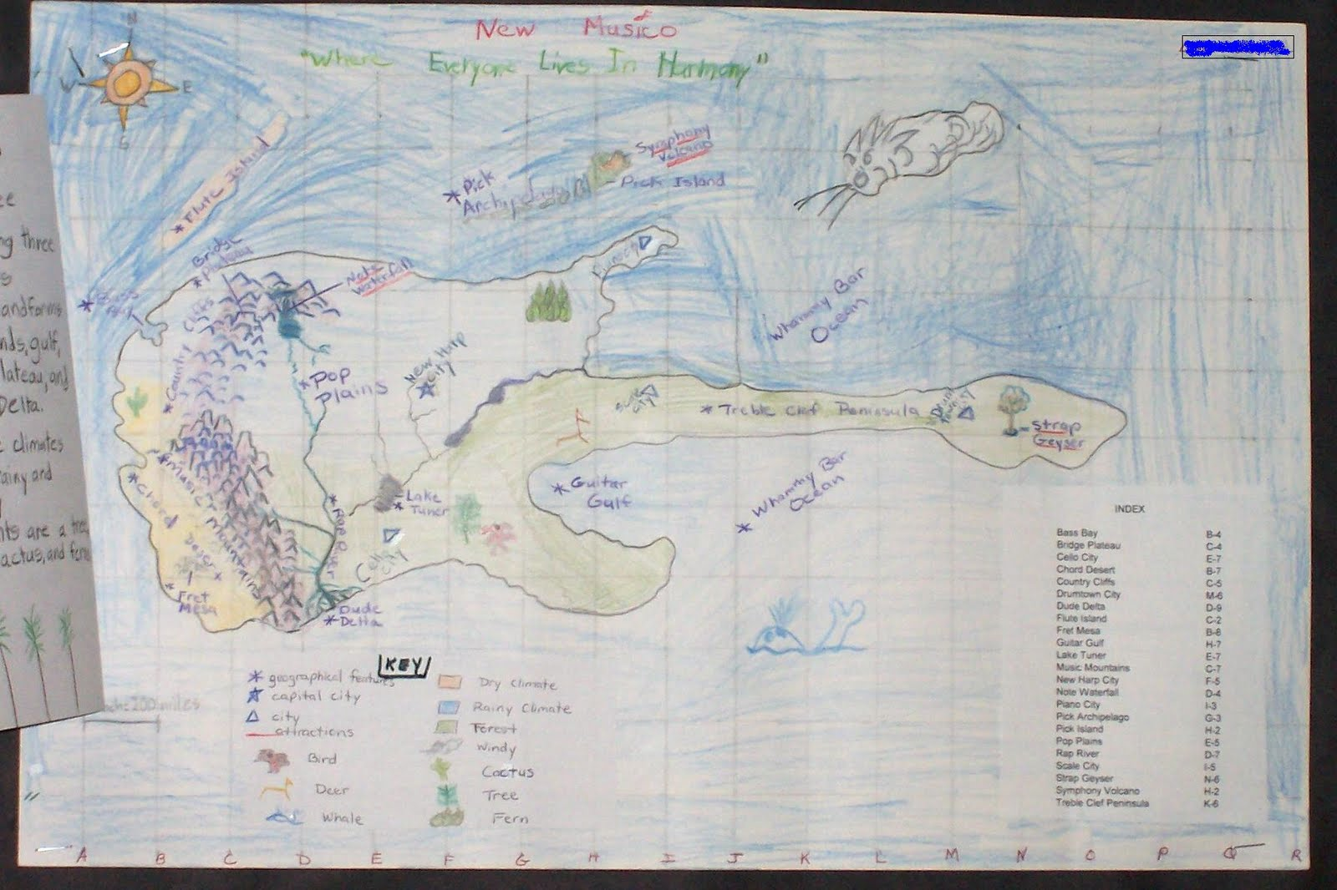

Slide 11
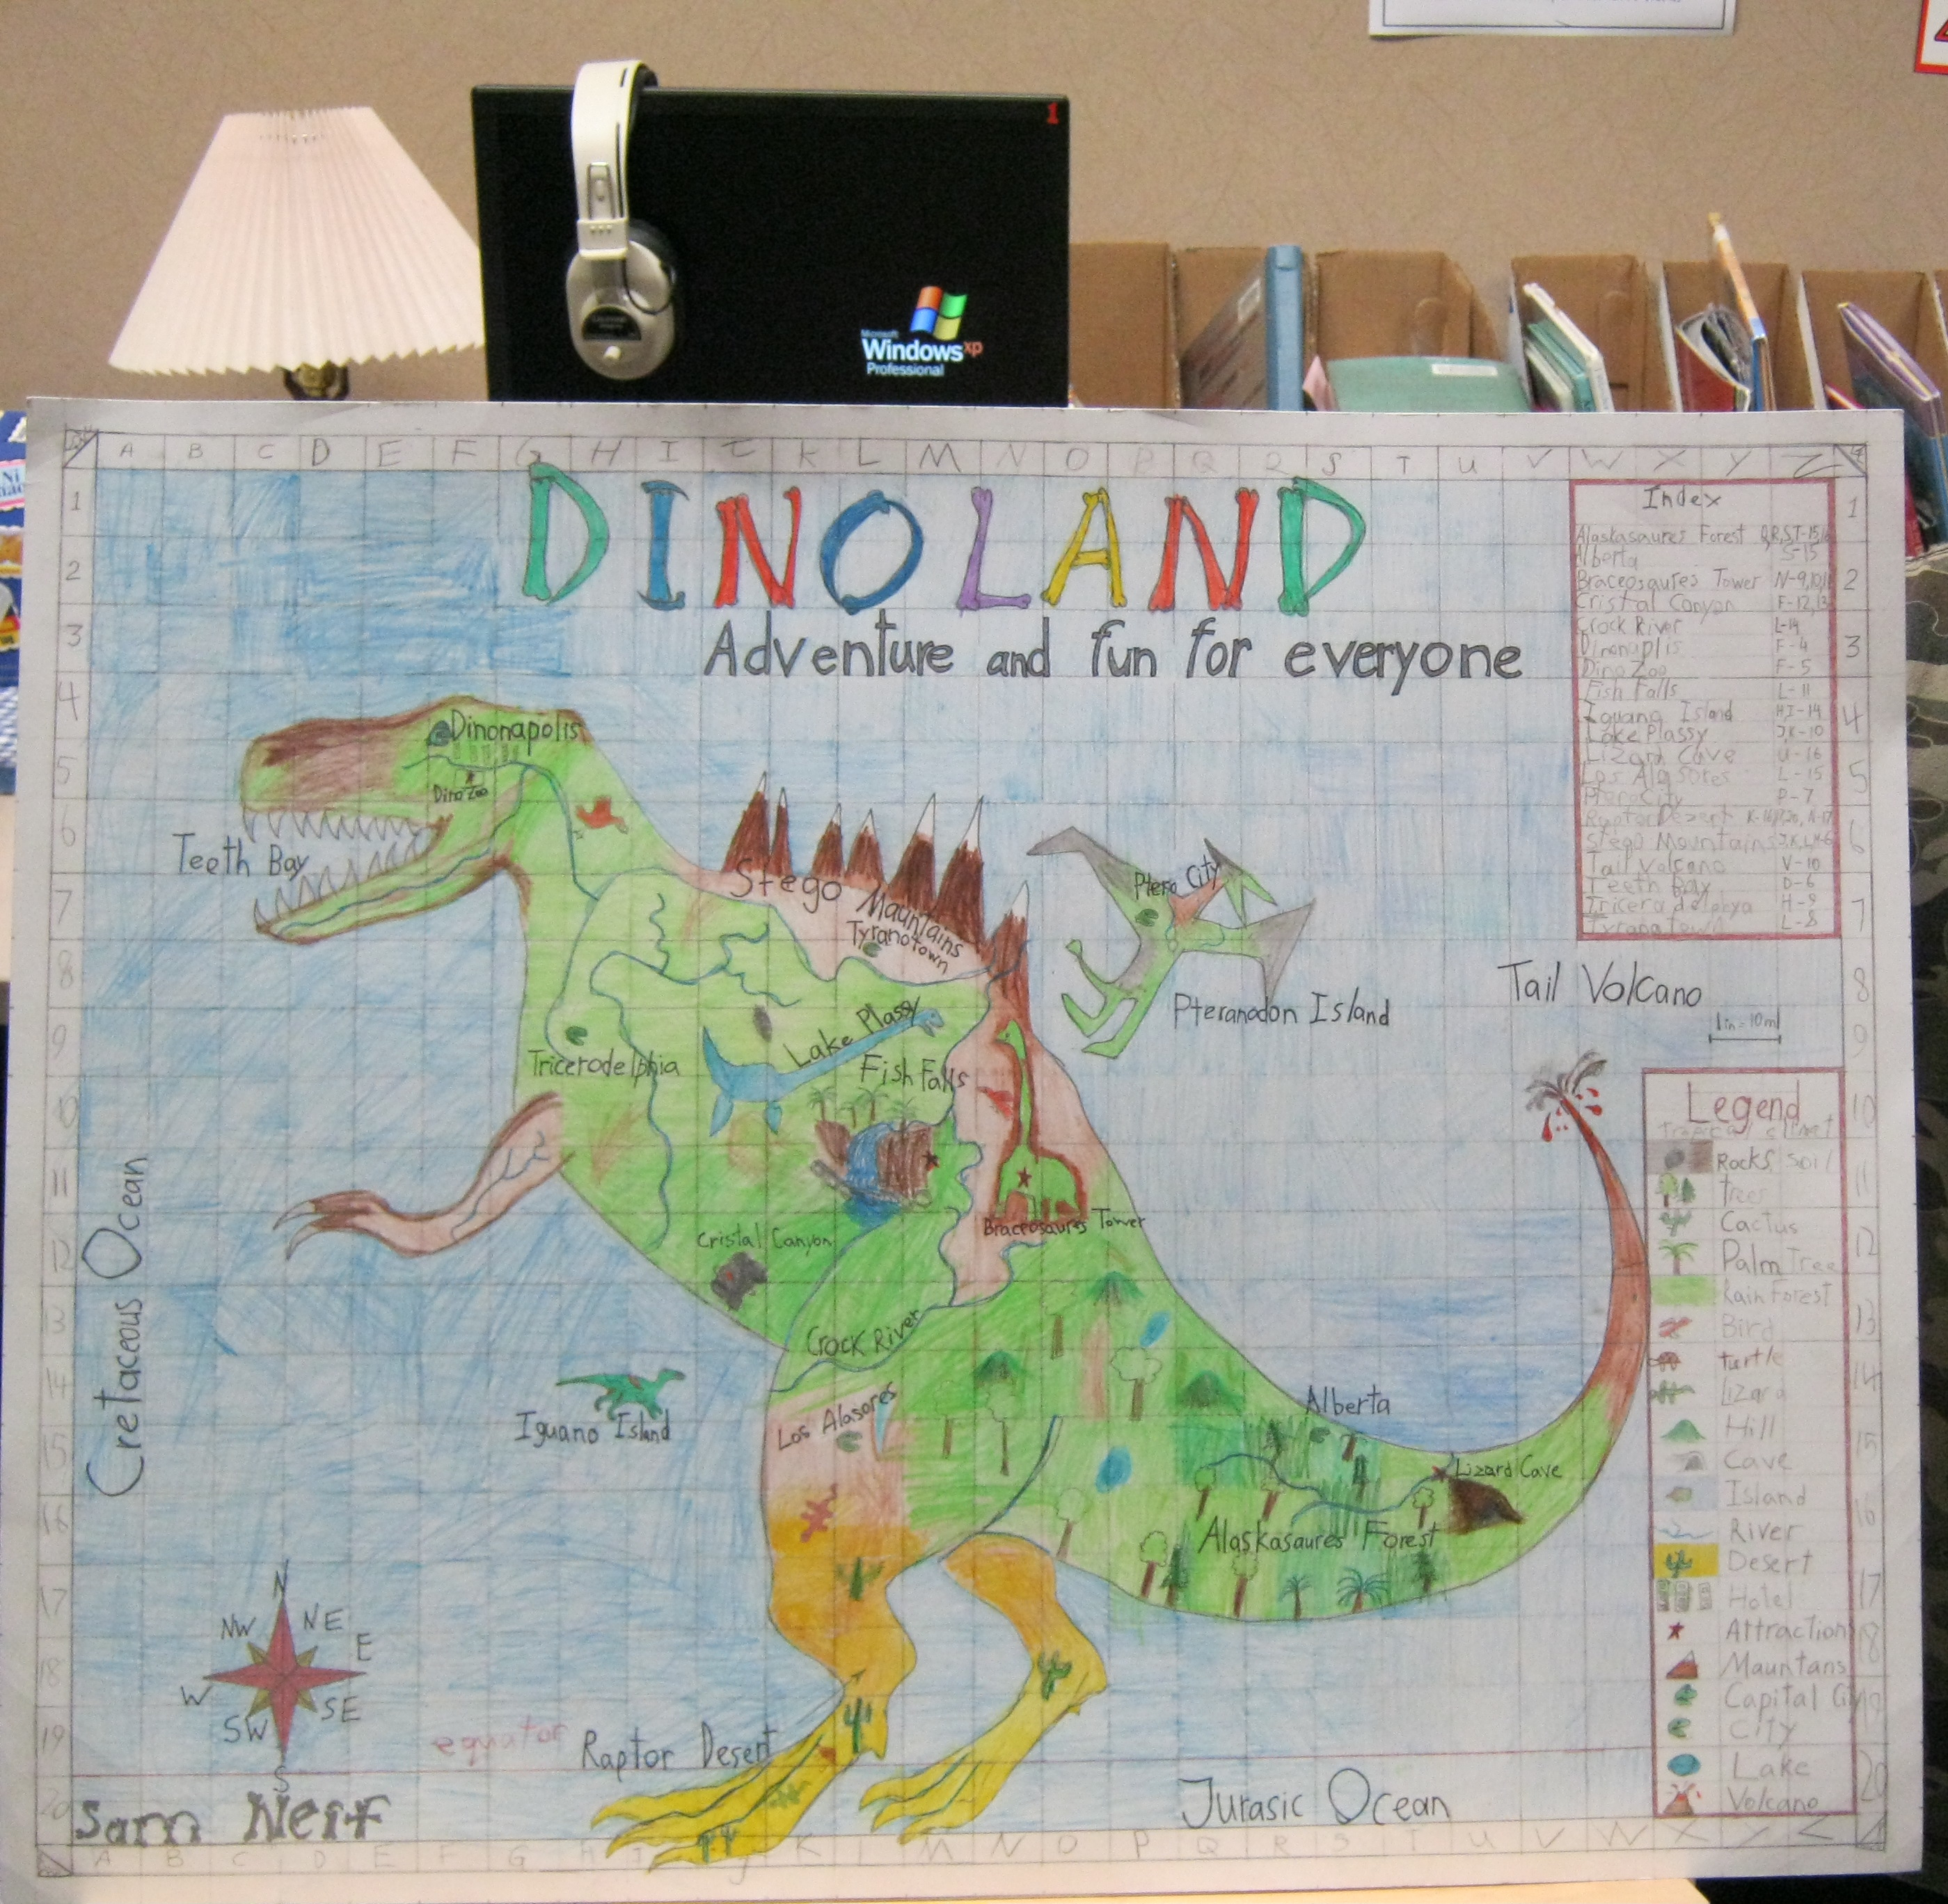

Slide 12
